Slide 1
CENG 3005 Database Management Systems Week 9
Normal Forms (continued)

Slide 2
Normalization
1NF (atomic, primary key):
{Order, Product, Customer, Address, Quantity, UnitPrice}
2NF (no partial dependency on key)
{Product, UnitPrice}
{Order, Product, Quantity}
{Order, Customer, Address}
3NF (no transitive dependence on a key)
{Product, UnitPrice}
{Order, Product, Quantity}
{Order, Customer}
{Customer, Address}

Slide 3
Normalization of DB Tables
Normalization
Process for evaluating and correcting table structures
determines the optimal assignments of attributes to entities
Normalization provides micro view of entities
focuses on characteristics of specific entities
may yield additional entities
Works through a series of stages called normal forms
1NF → 2NF → 3NF → 4NF (optional)
Higher the normal form, slower the database response
more joins are required to answer end-user queries
So if the response is slow, why do the database people normalize?
Reduce uncontrolled data redundancies
Help eliminate data anomalies
Produce controlled redundancies to link tables

Slide 4
Redundancy
Dependencies between attributes cause redundancy
Eg. All addresses in the same town have the same zip code
SSN Name Town Zip
1234 Joe Stony Brook 11790
4321 Mary Stony Brook 11790
5454 Tom Stony Brook 11790
………………….
Redundancy

Slide 5
Example
ER Model
SSN Name Address Hobby
1111 Joe 123 Main {biking, hiking}
Relational Model
SSN Name Address Hobby
1111 Joe 123 Main biking
1111 Joe 123 Main hiking
…………….
Redundancy

Slide 6
Anomalies
Redundancy leads to anomalies:
Update anomaly: If you need to change Address, you must change in multiple places (columns/tables)
Deletion anomaly: Suppose a person gives up all hobbies. Do we:
Set Hobby attribute to null? No, you can’t, because Hobby is part of key
Delete the entire row? No, since we lose other information in the row
Insertion anomaly: Hobby value must be supplied for any inserted row since Hobby is part of key

Slide 7
Decomposition of Tables
Solution: use two relations to store Person information
Person1 (SSN, Name, Address)
Hobbies (SSN, Hobby)
The decomposition is more general: people with hobbies can now be described
No update anomalies:
Name and address stored once
A hobby can be separately supplied or deleted

Slide 8
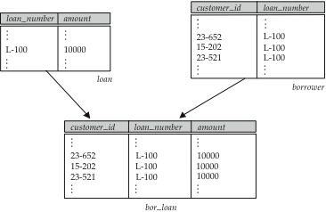
What if you need to combine tables?
Suppose we combine borrower and loan to get
bor_loan = (customer_id, loan_number, amount )
Result might cause a possible repetition of information (L-100 in example below)

Slide 9
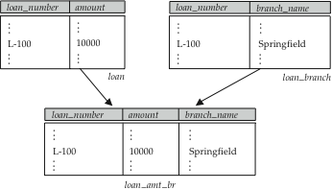
A Combined Schema Without Repetition
Consider combining loan_branch and loan
loan_amt_br = (loan_number, amount, branch_name)
No repetition (as suggested by example below)

Slide 10
How to decide whether to split into smaller tables?
Suppose we had started with bor_loan. How would we know to split up (decompose) it into borrower and loan?
Write a rule “if there were a schema (loan_number, amount), then loan_number would be a candidate key”
Denote as a functional dependency:
loan_number → amount
In bor_loan, because loan_number is not a candidate key, the amount of a loan may have to be repeated. This indicates the need to decompose bor_loan.
Not all decompositions are good. Suppose we decompose employee into
employee1 = (employee_id, employee_name)
employee2 = (employee_name, telephone_number, start_date)
The next slide shows how we lose information -- we cannot reconstruct the original employee relation -- and so, this is a lossy decomposition.

Slide 11
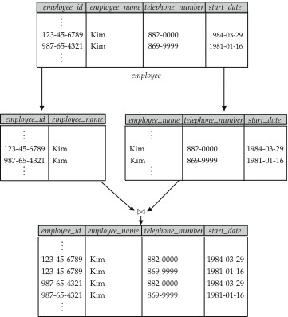
A Lossy Decomposition

Slide 12
First Normal Form
Domain is atomic if its elements are considered to be indivisible units
Examples of non-atomic domains:
Set of names, composite attributes
Identification numbers like CS101 that can be broken up into parts
A relational schema R is in first normal form if the domains of all attributes of R are atomic
Non-atomic values complicate storage and encourage redundant (repeated) storage of data
Example: Set of accounts stored with each customer, and set of owners stored with each account
We assume all relations are in first normal form

Slide 13
First Normal Form (Cont’d)
Atomicity is actually a property of how the elements of the domain are used.
Example: Strings would normally be considered indivisible
Suppose that students are given roll numbers which are strings of the form CS0012 or EE1127
If the first two characters are extracted to find the department, the domain of roll numbers is not atomic.
This leads to encoding of information in application program rather than in the database.

Slide 14
Goal — Devise a Theory for the Following
Decide whether a particular relation R is in “good” form.
If a relation R is not in “good” form, decompose it into a set of relations {R₁, R₂, ..., R_{n}} such that
each relation is in good form
the decomposition is a lossless-join decomposition
Our theory is based on:
functional dependencies
multivalued dependencies

Slide 15
How to determine Primary Key using Functional Dependencies
Watch the video!!!
https://www.youtube.com/watch?v=s1DNVWKeQ_w

Slide 16
Normalization Forms (simple simple simple)
“Data depends on the key [1NF]
the whole key [2NF]
and nothing but the key [3NF]”
“If all the arrows in FDs are out of a candidate key” [BCNF]

Slide 17
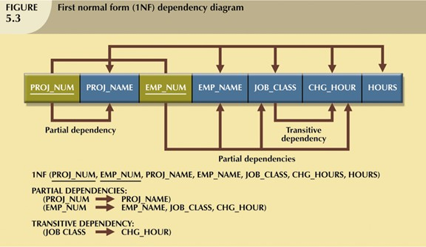
First normal form (1NF)
First normal form (1NF)
All data values are atomic
Each row is unique (has a primary key)
Step by step 1NF:
Eliminate repeating groups, eliminate all-null columns
Identify the Primary Key –Primary key must uniquely identify attribute value –New key must be composed
Identify All Dependencies –Dependencies can be depicted with help of a dependency diagram

Slide 18
Normalization of DB Tables
Normalization
Process for evaluating and correcting table structures
determines the optimal assignments of attributes to entities
Normalization provides micro view of entities
focuses on characteristics of specific entities
may yield additional entities
Works through a series of stages called normal forms
1NF → 2NF → 3NF → 4NF (optional)
Higher the normal form, slower the database response
more joins are required to answer end-user queries
Why normalize?
Reduce uncontrolled data redundancies
Help eliminate data anomalies
Produce controlled redundancies to link tables

Slide 19
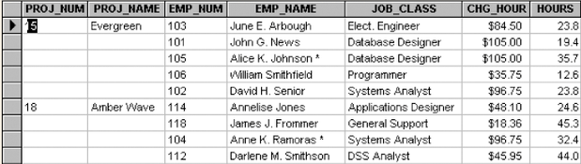
Example: Need for Normalization
PRO_NUM is intended to be primary key but contain nulls
Table entries invite data inconsistencies
e.g. “Elect. Engineer”, “Elect.Eng.”, “EE”
Table displays data redundancies that can cause data anomalies
Update anomalies
Modifying JOB_CLASS could require many alterations (all the rows for the same EMP_NUM)
Insertion anomalies
New employee must be assigned a project
Deletion anomalies
If employee quits and a row deleted, other vital data may get lost

Slide 20
Normalization: First Normal Form
First Normal Form (1NF)
All the primary key attributes are defined
There are no repeating groups
All attributes are dependent on the primary key
Conversion to 1NF
Objective
Develop a proper primary key
Steps
Eliminate repeating groups
fill in the null cells with appropriate data value
Identify primary key
identify attribute(s) that uniquely identifies each row
Identify all dependencies
make sure all attributes are dependent on the primary key

Slide 21
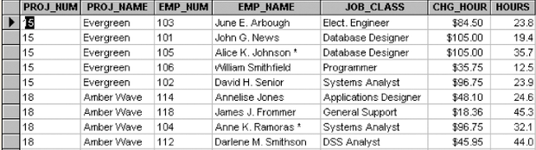
Normalization: 1NF example
Eliminate repeating groups - Fill in the null cells to make each row define a single entity
Identify the primary key - Make sure all attributes are dependent on the primary key

Slide 22
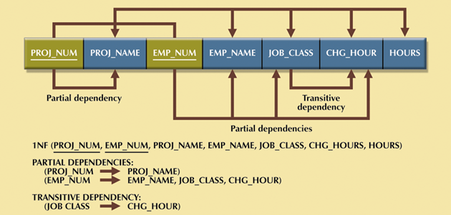
Normalization: 1NF example
Identify all dependencies (in a Dependency Table)
Desirable dependencies (arrows above)
based on primary key (functional dependency)
Less desirable dependencies (arrows below)
Partial dependency
based on part of composite primary key
Transitive dependency
one nonprime attribute depends on another nonprime attribute
Subject to data redundancies and anomalies

Slide 23
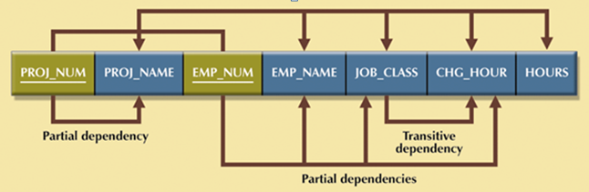
Normalization: Second Normal Form
Second Normal Form (2NF)
It is in 1NF
There are no partial dependencies
Conversion to 2NF
Objective
Eliminate partial dependencies
Steps
Start with 1NF format
Write each key component (w/ partial dependency) on separate line
Write original (composite) key on last line
Each component is new table
Write dependent attributes after each key
1NF (PROJ_NUM, EMP_NUM, PROJ_NAME, EMP_NAME, JOB_CLASS, CHG_HOUR, HOURS)
↓
PROJECT (PROJ_NUM, PROJ_NAME)
EMPLOYEE (EMP_NUM, EMP_NAME, JOB_CLASS, CHG_HOUR)
ASSIGN (PROJ_NUM, EMP_NUM, HOURS)

Slide 24
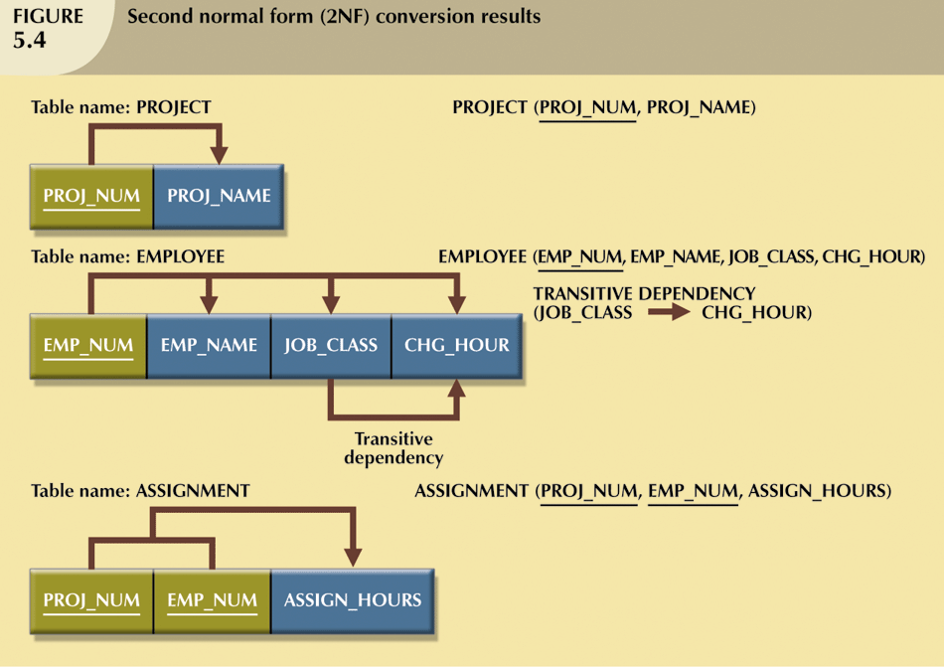
Normalization: 2NF example

Slide 25
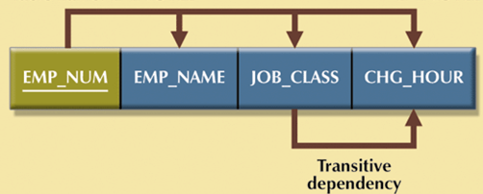
Normalization: Third Normal Form
Third Normal Form (3NF)
It is in 2NF
There are no transitive dependencies
Conversion to 3NF
Objective
Eliminate transitive dependencies (TD)
Steps
Start with 2NF format
Break off the TD pieces and create separate tables
EMPLOYEE (EMP_NUM, EMP_NAME, JOB_CLASS, CHG_HOUR)
↓
EMPLOYEE (EMP_NUM, EMP_NAME, JOB_CLASS)
JOB (JOB_CLASS, CHG_HOUR)

Slide 26
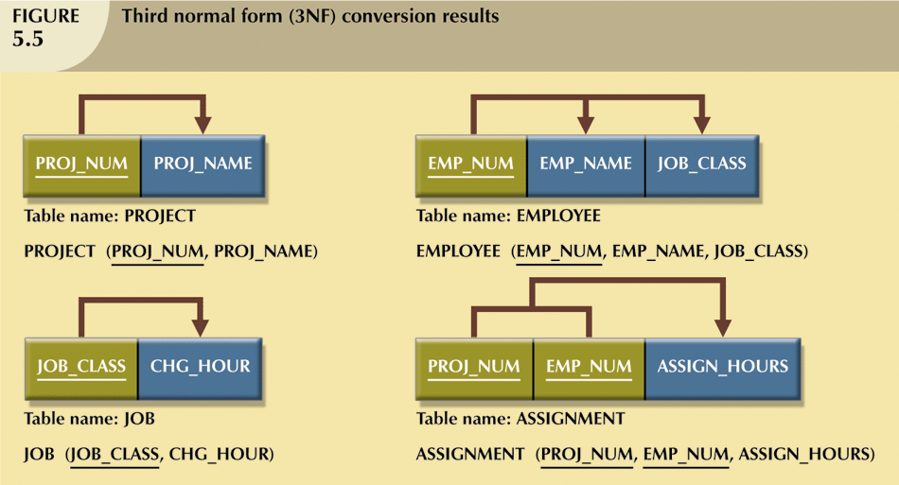
Normalization: 3NF example

Slide 27
